Slide 1


Office World Supply sales

Slide 2
Introduction
This data refers to the supply and sale of office stationery across the regions of the world.
The data aims to represent the sale of office stationery mainly by categories and sub-categories.
This project intends to analyse the popularity and profitability of all office stationaries by categories, sub-categories, region, and current customer base.
The goal of the analysis is to allow marketing folks to understand the current sale patterns so that they can plan to reach more customers with the right products.

Slide 3
Background and Context
The data source on the sale of office stationery is raw and incorrectly formatted at places which suggests it could be manually created or curated through multiple information systems
It represents the data for the first two quarters for the year 2023
During data preparation for analysis, this involves steps taken to clean and preprocess the database to ensure its quality and reliability. The following data issues were identified and resolved through data cleansing.
  Incorrect Spellings
  Duplicate rows
  Inconsistent date formats
  Missing information
  Improve data through lookup where appropriate
Descriptive and predictive analysis is mainly used to analyse the data once the data is cleansed

Slide 4
Uncleaned Data
Order Date | Ship Date | Order ID | Order Priority | Customer ID | Customer Name | Ship Mode | Customer Segment | Product Category | Product Sub-Category | Product Container | Product Name | Region | Quantity ordered new | Discount | Sales | Shipping Cost | Unit Price | Profit
30/06/2023 | 01/07/2023 | 36647 | High | 699 | Jenny Gold | Royal Mail | Consumer | Office Supplies | Rubber Bands | Wrap Bag | Staples Vinyl Coated Paper Clips, 800/Box | West | 32 | 0.01 | 274.26 | 2.82 | 7.89 | 38.7
30/06/2023 | 01/07/2023 | 36647 | High | 699 | Jenny Gold | Royal Mail | Consumer | Office Supplies | Scissors, Rulers and Trimmers | Wrap Bag | *Staples* vLetter Openers, 2/Pack | West | 24 | 0.09 | 83.16 | 1.32 | 3.68 | -21.91
30/06/2023 | 03/07/2023 | 36647 | High | 699 | Jenny Gold | Royal Mail | Consumer | Office Supplies | Storage & Organization | Small Box | Filing/Storage Totes and Swivel Casters | West | 27 | 0.1 | 261.93 | 9.45 | 9.71 | -119.77
30/06/2023 | 01/07/2023 | 87979 | High | 702 | Kelly O'Connor | Royal Mail | Consumer | Office Supplies | Rubber Bands | Wrap Bag | Staples Vinyl Coated Paper Clips, 800/Box | West | 8 | 0.01 | 68.56 | 2.82 | 7.89 | 46.44
30/06/2023 | 01/07/2023 | 87979 | High | 702 | Kelly O'Connor | Royal Mail | Consumer | Office Supplies | Scissors, Rulers and Trimmers | Wrap Bag | *Staples* vLetter Openers, 2/Pack | West | 6 | 0.09 | 20.79 | 1.32 | 3.68 | -17.528
30/06/2023 | 03/07/2023 | 87979 | High | 702 | Kelly O'Connor | Royal Mail | Consumer | Office Supplies | Storage & Organization | Small Box | Filing/Storage Totes and Swivel Casters | West | 7 | 0.1 | 67.91 | 9.45 | 9.71 | -95.816
30/06/2023 | 07/07/2023 | 91451 | Low | 1307 | Teresa Hill | Royal Mail | Small Business | Technology | Computer Peripherals | Small Pack | 80 Minute Slim Jewel Case CD-R , 10/Pack - Staples | West | 16 | 0.04 | 131.26 | 1.99 | 8.33 | 44.892
30/06/2023 | 02/07/2023 | 89407 | Not Specified | 1384 | George McLamb | Royal Mail | Consumer | Office Supplies | Storage & Organization | Small Box | X-Rack™ File for Hanging Folders | South | 11 | 0.07 | 123.18 | 5.03 | 11.29 | -163.03
30/06/2023 | 01/07/2023 | 87078 | Not Specified | 1472 | Tommy Ellis Ritchie | FedEx | Home Office | Technology | Computer Peripherals | Small Box | Logitech Internet Navigator Keyboard | East | 17 | 0.02 | 552.89 | 6.5 | 30.98 | -44.624
30/06/2023 | 06/07/2023 | 88348 | Low | 2089 | Annie Odom | Royal Mail | Corporate | Office Supplies | Appliances | Small Box | Fellowes Superior 10 Outlet Split Surge Protector | East | 17 | 0.06 | 652.84 | 4.5 | 38.06 | 450.4596
30/06/2023 | 08/07/2023 | 88348 | Low | 2089 | Annie Odom | Royal Mail | Corporate | Technology | Copiers and Fax | Large Box | Hewlett Packard LaserJet 3310 Copier | East | 22 | 0.08 | 12750.99 | 24.49 | 599.99 | 8798.1831
30/06/2023 | 04/07/2023 | 88348 | Low | 2089 | Annie Odom | FedEx | Corporate | Office Supplies | Paper | Wrap Bag | Unpadded Memo Slips | East | 5 | 0.1 | 20.54 | 2.97 | 3.98 | -5.385
30/06/2023 | 30/06/2023 | 91502 | Not Specified | 2276 | Dennis Block Richardson | Royal Mail | Consumer | Technology | Telephones and Communication | Small Box | T28 WORLD | East | 22 | 0.01 | 3846.06 | 8.99 | 195.99 | 2653.7814
30/06/2023 | 07/07/2023 | 40224 | Low | 2882 | Andrew Gonzalez | FedEx | Consumer | Furniture | Office Furnishings | Small Box | Howard Miller 16" Diameter Gallery Wall Clock | South | 21 | 0.05 | 1336.35 | 14.48 | 63.94 | 270.8743
30/06/2023 | 07/07/2023 | 87634 | Low | 2885 | Gary Frazier | FedEx | Consumer | Furniture | Office Furnishings | Small Box | Howard Miller 16" Diameter Gallery Wall Clock | East | 5 | 0.05 | 318.18 | 14.48 | 63.94 | 219.5442
30/06/2023 | 02/07/2023 | 86432 | Critical | 3119 | Jay Hubbard | Hermes | Corporate | Furniture | Tables | Jumbo Drum | SAFCO PlanMaster Heigh-Adjustable Drafting Table Base, 43w x 30d x 30-37h, Black | South | 11 | 0.08 | 3772.19 | 60 | 349.45 | 513.084
29/06/2023 | 29/06/2023 | 86914 | Not Specified | 1183 | Becky O'Brien | Royal Mail | Home Office | Technology | Telephones and Communication | Small Pack | Accessory9 | West | 9 | 0.04 | 266.95 | 3.3 | 35.99 | 184.1955
29/06/2023 | 03/07/2023 | 89194 | Low | 1502 | Renee Huang | FedEx | Small Business | Office Supplies | Pens & Art Supplies | Wrap Bag | Quartet Omega® Colored Chalk, 12/Pack | South | 11 | 0.08 | 61.39 | 1 | 5.84 | 731.922
29/06/2023 | 02/07/2023 | 89194 | Low | 1502 | Renee Huang | Royal Mail | Small Business | Technology | Telephones and Communication | Small Box | StarTAC 8000 | South | 13 | 0 | 2435.52 | 8.99 | 205.99 | 186.558
29/06/2023 | 29/06/2023 | 86410 | Medium | 1109 | Dennis Welch | Royal Mail | Consumer | Furniture | Office Furnishings | Large Box | Westinghouse Clip-On Gooseneck Lamps | Central | 13 | 0.08 | 108.99 | 10.16 | 8.37 | -169.232
29/06/2023 | 01/07/2023 | 87790 | High | 2448 | Melanie Morrow | Royal Mail | Consumer | Office Supplies | Paper | Small Box | Xerox 214 | Central | 16 | 0.09 | 96.96 | 7.03 | 6.48 | -126.208
29/06/2023 | 30/06/2023 | 87474 | High | 3374 | Jamie Ward | Royal Mail | Home Office | Technology | Computer Peripherals | Small Box | Keytronic 105-Key Spanish Keyboard | East | 8 | 0.05 | 600.4 | 12.14 | 73.98 | -1.904
Cleaned Data
Order Date | Ship Date | Order ID | Order Priority | Customer ID | Customer Name | Ship Mode | Customer Segment | Product Category | Product Sub-Category | Product Container | Product Name | Region | Manager LOOKUP | Quantity ordered new | Discount | Sales | Shipping Cost | Unit Price | Profit | Profit Status
01/01/2023 | 10/01/2023 | 86234 | Low | 3275 | Tamara Dickinson | Royal Mail | Small Business | Office Supplies | Pens & Art Supplies | Wrap Bag | Newell 312 | West | William | 6 | £0.01 | £36.09 | £1.20 | £5.84 | £20.38 | Profit
01/01/2023 | 03/01/2023 | 90539 | Low | 1418 | Rebecca Lindsey | Royal Mail | Small Business | Office Supplies | Pens & Art Supplies | Wrap Bag | *Staples* Highlighting Markers | North | #N/A | 8 | £0.07 | £36.58 | £0.71 | £4.84 | £25.24 | Profit
01/01/2023 | 02/01/2023 | 91371 | Not Specified | 1910 | Sean Stephenson | Royal Mail | Home Office | Office Supplies | Binders and Binder Accessories | Small Box | Binding Machine Supplies | South | Sam | 2 | £0.02 | £63.32 | £6.27 | £29.17 | £36.91 | Profit
01/01/2023 | 03/01/2023 | 88028 | Not Specified | 2211 | Anita Hahn | FedEx | Home Office | Office Supplies | Storage & Organization | Large Box | Safco Industrial Wire Shelving | East | Erin | 2 | £0.08 | £193.88 | £35.00 | £95.99 | -£425.21 | Loss
01/01/2023 | 02/01/2023 | 89665 | High | 2124 | Paige Powers | Royal Mail | Consumer | Technology | Computer Peripherals | Small Pack | Verbatim DVD-RAM, 9.4GB, Rewritable, Type 1, DS, DataLife Plus | South | Sam | 13 | £0.04 | £609.09 | £1.99 | £45.19 | -£61.19 | Loss
01/01/2023 | 04/01/2023 | 87486 | Critical | 1552 | Gary Koch | Hermes | Small Business | Furniture | Tables | Jumbo Box | Bretford CR4500 Series Slim Rectangular Table | South | Sam | 2 | £0.01 | £723.54 | £40.19 | £348.21 | -£337.09 | Loss
01/01/2023 | 06/01/2023 | 89450 | Low | 1425 | Gregory Crane | Hermes | Small Business | Technology | Office Machines | Jumbo Drum | Lexmark 4227 Plus Dot Matrix Printer | West | William | 1 | £0.04 | £2,013.67 | £14.70 | £2,036.48 | -£4,793.00 | Loss
01/01/2023 | 05/01/2023 | 86234 | Low | 3275 | Tamara Dickinson | Royal Mail | Small Business | Technology | Copiers and Fax | Large Box | Canon PC940 Copier | West | William | 12 | £0.04 | £5,183.89 | £24.49 | £449.99 | £3,576.88 | Profit
02/01/2023 | 04/01/2023 | 90853 | Critical | 1155 | Alex Nicholson | FedEx | Consumer | Office Supplies | Paper | Wrap Bag | Black Print Carbonless Snap-Off® Rapid Letter, 8 1/2" x 7" | West | William | 4 | £0.09 | £34.41 | £2.15 | £9.11 | £20.30 | Profit
02/01/2023 | 04/01/2023 | 89083 | Critical | 950 | Jane Shah | Royal Mail | Consumer | Office Supplies | Binders and Binder Accessories | Small Box | Avery Trapezoid Ring Binder, 3" Capacity, Black, 1040 sheets | Central | Chris | 1 | £0.06 | £41.60 | £2.99 | £40.98 | -£14.80 | Loss
02/01/2023 | 03/01/2023 | 89961 | Medium | 164 | Robin Kramer Vaughn | ParcelToGo | Home Office | Office Supplies | Paper | Small Box | Xerox 1952 | West | William | 9 | £0.02 | £45.63 | £5.49 | £4.98 | -£77.03 | Loss
02/01/2023 | 04/01/2023 | 85858 | Medium | 258 | Allan Shields | ParcelToGo | Consumer | Technology | Computer Peripherals | Small Pack | Maxell Pro 80 Minute CD-R, 10/Pack | South | Sam | 3 | £0.05 | £52.47 | £1.99 | £17.48 | -£127.01 | Loss
02/01/2023 | 04/01/2023 | 9285 | Critical | 949 | Ernest Oh | Royal Mail | Consumer | Office Supplies | Binders and Binder Accessories | Small Box | Avery Trapezoid Ring Binder, 3" Capacity, Black, 1040 sheets | West | William | 3 | £0.06 | £124.81 | £2.99 | £40.98 | -£19.10 | Loss
02/01/2023 | 02/01/2023 | 90853 | Critical | 1155 | Alex Nicholson | Royal Mail | Consumer | Office Supplies | Paper | Wrap Bag | White Glue Top Scratch Pads | West | William | 11 | £0.08 | £157.27 | £1.97 | £15.04 | £108.52 | Profit

Slide 5
Data Sources and Methodology
The data source is the database of real-time collection of office stationery order fulfillment
Analysis applied via Excel Tool Pak:
  Descriptive Statistics
  Correlational
  Regression
  Predictive analysis
Visuals and Graphs for data representation
Forecasting (Formula and graph) for pridiction

Slide 6
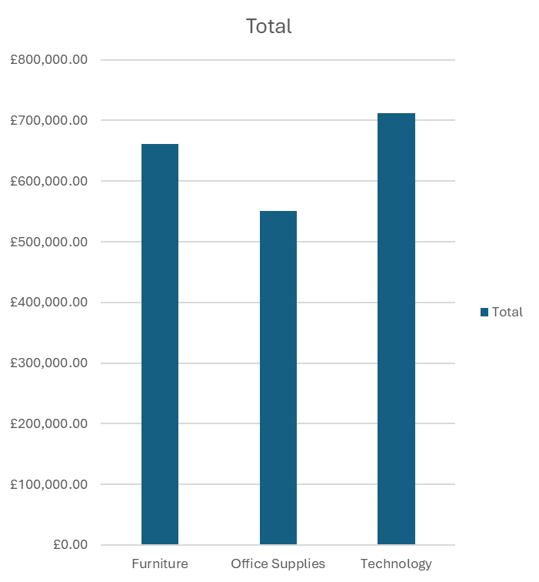
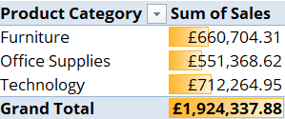
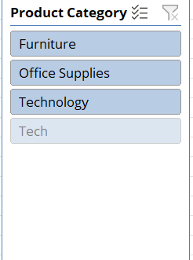
Key Findings or Results
Sales by product category
Highest sale: Technology

Slide 7
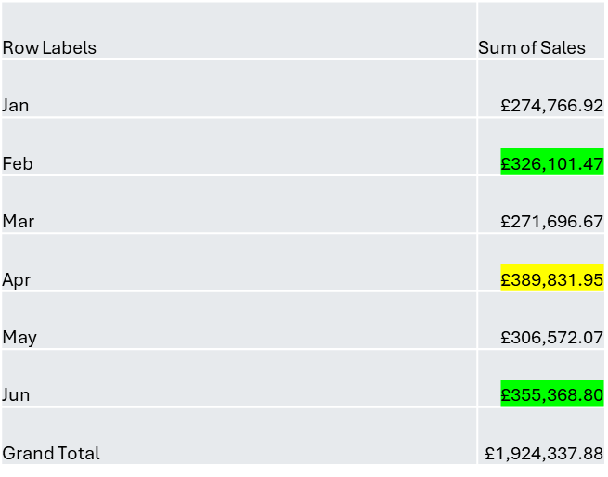
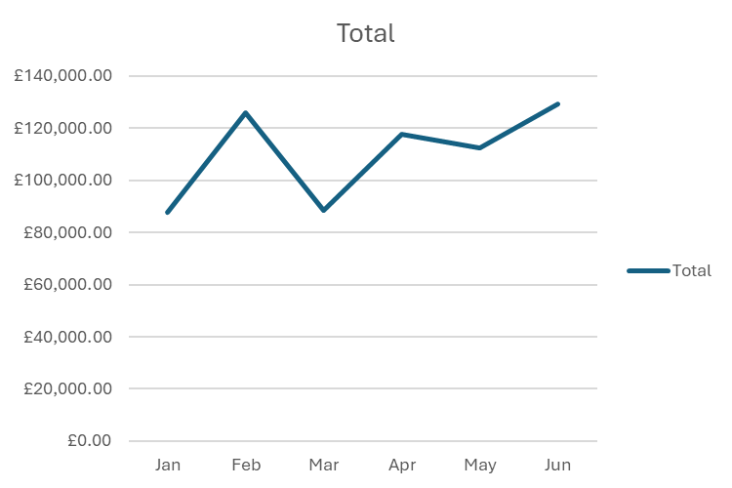
Sales Timeline
Combined sales are higher in the second quarter of the year
Furniture sales are highest in the month of Feb and June
Office supplies sales peaked in April

Slide 8

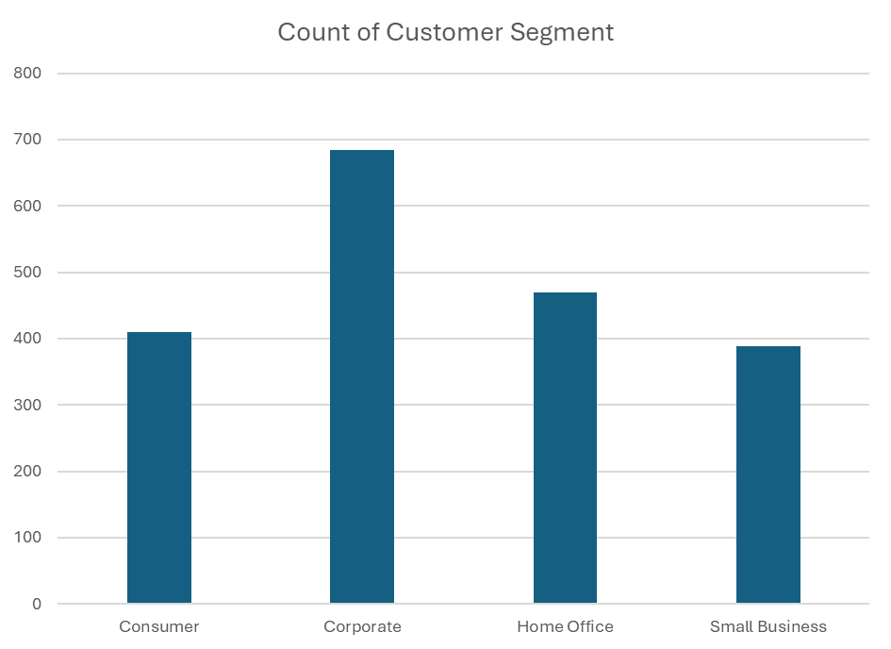
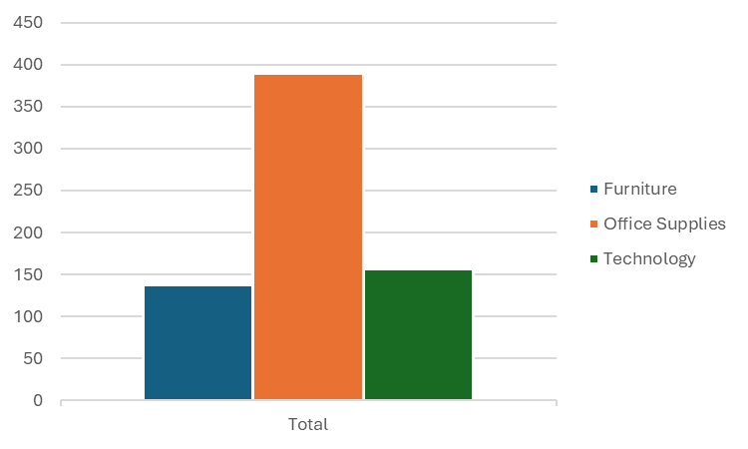
Customer base by segment
Corporate consumers represent the biggest customer base
The following bar chart shows categories sold to Corporate customers which states that the corporate customer base buys across all categories

Slide 9
Analysis and Interpretation
The goal of the analysis is to determine which product categories and sub-categories are profitable and who are their biggest consumers.
Customer base is interpreted by the segment
Sales are analysed on product categories and subcategories
Profits are interpreted by customer segment again

Slide 10
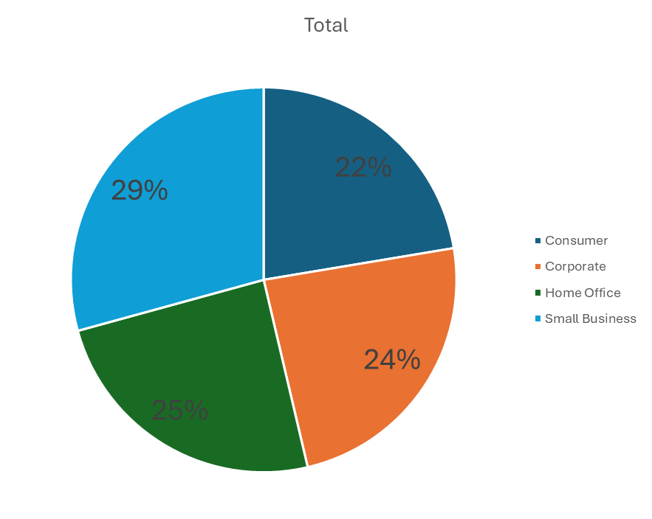

Profit by Customer Segment
Though Sales are higher from Corporate customers the profits are higher through Small business

Slide 11

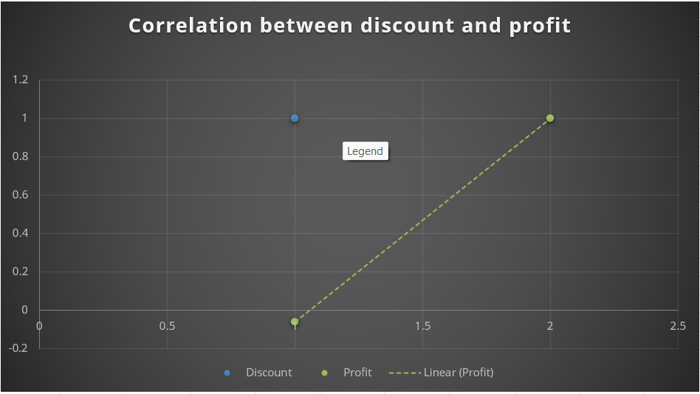
Correlation between discount and profit

Slide 12
Conclusion
Sales for category technology are the highest
The largest customer base is represented by Corporate customers.
Though sales are higher by corporate customers high profits are generated through small businesses.

Slide 13
Recommendations
Promotion campaign and marketing should be increased in the months with lower sales for ex: Jan and Mar in the first quarter
Optimize the pricing structure so that profits from large customer segments can be increased for ex: Corporate as the sales are high but profits are low
Product categories are quite competent with each other however office supplies are relatively weaker hence it is important to identify the reason for the same.

Slide 14
